Slide 1
A1024 Section 3 Presentation to Local Community (Sample)

Slide 2
The [City/County] recently received the following grant award:
Grant Contract No. [##]
Award Amount: [$XXX,XXX]
Project: [description]

Slide 3
The grant is funded through the Community Development Block Grant, via:
U.S. Department of Housing and Urban Development
and
Texas Department of Agriculture

Slide 4
Section 3 Concepts
As a condition of funding, the [City/County] must comply with Section 3 of the Housing and Urban Development Act of 1968.
To the greatest extent feasible, Grant Recipients must direct economic opportunities generated by CDBG funds to low- and very low-income persons.

Slide 5
Section 3 Concepts
In part, this means ensuring that:
Section 3 Businesses have the information to submit a bid or proposal for the project; and
Section 3 Workers have information about any available job opportunities related to the project.
For precise definitions, see TxCDBG Policy Issuance 20-01

Slide 6
Section 3 Business
A company may qualify as a Section 3 Business if:
it is owned by low-income persons;
it is owned by Section 8-Assisted housing residents; or
75% of all labor hours for the business in a 3 month period are performed by Section 3 Workers
Register at:
HUD’s Section 3 website: https://portalapps.hud.gov/Sec3BusReg/BRegistry/RegisterBusiness
[local/regional registry for disadvantaged businesses if applicable]

Slide 7
Section 3 Business
This project is expected to include the following contracting opportunities:
Grant Administration services (previously selected)
Engineering Services (previously selected)
Prime Contractor for [short description]
Subcontractors for [list trades]
[note: list all bid and/or small purchase opportunities expected for the project]

Slide 8
Section 3 Worker
You may qualify as a Section 3 Worker if:
Your annual income is below the county threshold for your family size:
You are a current or recent Youthbuild participant
Register your information and search for opportunities at:
WorkInTexas.gov
HUD’s Section 3 Opportunity Portal https://hudapps.hud.gov/OpportunityPortal/
[local/regional job board if applicable]
Notes:
In practice – expect most contractors to calculate the LMI status for all workers based on payroll and family size.

Slide 9
Targeted Section 3 Worker
Section 3 Workers that reside near the project location may also qualify as Targeted Section 3 Workers.
For this project, that service area is defined by this map:
[Service Area Map here]

Slide 10
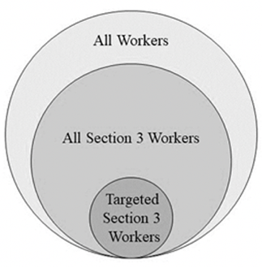
Recordkeeping
The [City/County] will track all hours worked on the project based on the three categories of workers.
This will require collection of certain income information.

Slide 11
For More Information
TxCDBG Policy Issuance 20-01
REVISED Policy Issuance 20-01 Section 3 v1.pdf (texasagriculture.gov)
24 CFR Part 75
Electronic Code of Federal Regulations (eCFR)
[name of local contact]

