Slide 1
Texas Community Development Block Grant Program
Civil Rights Policies and Resolutions
Notes:
Good afternoon and thank you for joining us for today’s CDBG Over Coffee. I’m Krystal Loera and I am one of the Grant Specialists for the Texas Community Development Block Grant Program.
A couple housekeeping items before we get started.
Please mute your lines and feel free to use the chat feature to ask questions. We’ll also take general questions after the presentation, but if you have project- or community-specific questions, please reach out via email.
Alright let’s get started!

Slide 2
TxCDBG Program
Civil Rights Policies and Resolutions

Slide 3
Introduction
The purpose of the policies associated with Civil Rights is to comply with state and federal requirements to ensure equal opportunity and access to all benefits that come with being a Texas CDBG Grant recipient.
https://www.texasagriculture.gov/GrantsServices/RuralEconomicDevelopment/RuralCommunityDevelopmentBlockGrant(CDBG)/Forms.aspx
Notes:
The Civil Rights Requirements can be found in Chapter 10 of the Implementation Manual located on the TDA website. If you go to the Grant Services tab and select the link for CDBG you will find the implementation manual link and under the column for 2022 you can download chapter 10 as well as the forms associated with Civil Rights.
Please note that the forms being discussed today are not specific to Group A and include documents that will need to be uploaded to the organization page as well.

Slide 4
Civil Rights Policies
There are several forms associated with the Civil Rights Policy requirements that will need to be uploaded to Group A in TDA-GO.
Resolution Adopting/Affirming Community Policies
Section 3 Service Area Map
Fair Housing Activities
Required Non-Discrimination Notices
Notes:
There have been some changes to the civil rights policy requirements but not necessarily anything that is being done away with but rather how they are completed and submitted in TDA-Go.
The most significant change that we have seen with our current paper contracts has been related to the Section 3 Policy. As you may have noticed this policy is not listed here. The form A1002 is no longer exists, however, the Section 3 items are still required and have replaced this policy form. These items are the Section 3 Map, job/bid postings, council presentation and new section added to the Project Completion Report.
The same type of change applies to the Limited English Proficiency Plan as the A1010 will no longer be required as a form, but the data will need to be entered as part of Group A and appropriate actions taken accordingly.
In order to tie all the changes together the grant recipient’s Civil Rights resolution form A1014 will be used to affirm that these requirements are being fulfilled, acknowledged, and practiced by the grant recipient. A policy/plan document attached to prove the affirmation is not required.
The additional requirements for grant recipients with 15 or more employees remains the same.

Slide 5
Civil Rights Policies
Forms/Performance Report/Group A
Notes:
As shown here, there are four different Civil Rights related forms to upload in Group A. Best practice is to name the file you are uploading to reflect the document name listed in TDA-Go. Once these forms are uploaded you will have to select from the dropdown below to indicate whether your organization employs 15 or more persons and if the answer is yes, your organization will be subject to the additional Section 504 requirements.

Slide 6
Civil Rights Policies
Section 504 Requirements:
Section 504/Grievance Procedure – Form A1004
Notice of Non-Discrimination Disabled/Handicap – Form A1005
Section 504/Self-Evaluation – Form A1006
Notes:
The two forms that make-up the Section 504 requirements are 1) the notice of non-discrimination that will be uploaded to Group A and 2) the grievance procedure form that is uploaded to the Organization Details tab of your Organization page.
The Section 504 requirements prohibit discrimination in federally-assisted programs based on disability and serve to ensure that qualified individuals with disabilities have access to programs and activities that received federal funds. If your organization meets the criteria, you must adopt grievance procedures that incorporate due process standards and allow for prompt resolution to complaints alleging any actions prohibited by Section 504.
Form 1005 is a notice of non-discrimination that serves to notify all participants that your organization does not discriminate on the basis of handicap, and it must identify the Civil Rights Officer who is the individual designated to coordinate your organizations Section 504 compliance.
During the agreement period, a self-evaluation of Section 504 compliance must be completed and kept on file for monitoring purposes. Grant Recipients must consult with individuals with disabilities or organizations representing them and modify policies that do not meet Section 504 policy requirements accordingly and if unresolved may result in corrective action taken to remedy any discrimination found. The self-evaluation form is a universal document and can be used if previously completed as long as the information is still accurate.

Slide 7
Civil Rights Policies
Grant recipients with 15 or more employees are required to include these additional forms.
Required notices may be posted to the City / County website and should remain available to the public throughout the life of the grant agreement, and at a minimum must be posted for 60 days.
Notes:
Here are the sample forms for the Section 504 Requirements. Posting these notices to the Grant Recipient’s website is best practice and screenshots should be accompanied by a posting affidavit (Form A100). Newspaper notices must be published no more than two years prior to the grant agreement start date, and no later than the grant agreement end date. This means that published notices can be used for multiple TxCDBG projects with grant periods that occur consecutively.

Slide 8
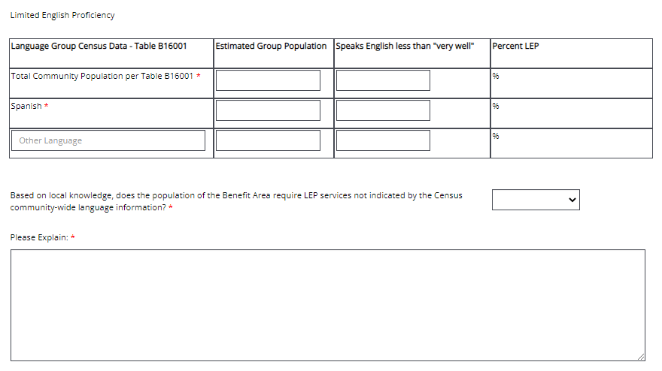
Civil Rights Policies
Limited English Proficiency Table 1
LEP Final Guidance - FAQs | HUD.gov / U.S. Department of Housing and Urban Development (HUD)
Notes:
What is the purpose of LEP? These services are required by HUD for individuals who do not speak English as their first language and who may be limited in their abilities to read, write, or understand English. If the population you are serving is primarily made of up non-English speaking individuals, they need to have the same access to fair housing information. For more information you can go to the HUD websites FAQ page.
In the first table for the LEP requirement you will see fields to fill out to help determine if your population requires LEP services. Spanish is the default language listed in the table, but you may add additional or alternative languages by clicking the plus sign at the bottom right hand of this table. After these criteria are entered you will select yes or no regarding whether your population meets the LEP requirement. There is a space below to allow for and explanation of how the population of the benefit area was determined to meet or not meet these requirements.

Slide 9
Civil Rights Policies
Limited English Proficiency Table 2
Notes:
The second LEP table will need to include a description of the resources available to your organization as well as which of the resources will be used for this grant agreement. The services include written translation of vital documents, verbal and oral translation of vital documents upon request, oral translation for public meetings, and referral to a community liaison proficient in the LEP language. There is an additional field available to enter any other LEP services your organization wishes to provide.
Please note that this second table must be filled in even if you do not meet the LEP percentage requirement. Your organization must demonstrate that these LEP services would be available if the LEP threshold was met.

Slide 10
Civil Rights Policies
Universal Civil Rights Forms:
The remainder of the required Civil Rights documents will need to be uploaded to your organization’s details page.
Notes:
The remaining Civil Rights forms include the Citizen Participation Plan and Complaint Procedures, the Excessive Force Policy, the Code of Conduct the Fair Housing Policy, and the 504 Grievance Procedures as discussed earlier. These documents are added to the organization’s page under organization details and represent the required policy forms for all agreements assigned to your organization.
When you navigate to your organization’s details page it will allow you to upload these forms. Be sure to include a description of each document, as the required form fields are not established you as in Group A.
Once uploaded, these forms will be available for all TDA-GO grants and do not need to be re-attached each time. Instead, the resolution passed for each grant will affirm that these policies remain in effect.

Slide 11
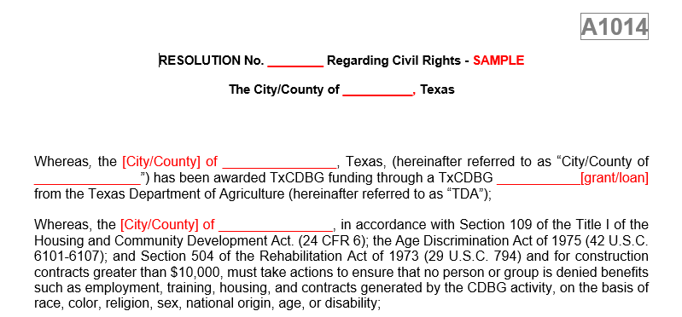
Civil Rights Forms
A Sample Civil Rights Resolution can be found on the Implementation Manual, Forms, and Appendices page of the TDA Website.
Notes:
On this sample resolution form, all the required policies to be adopted/reaffirmed are listed and the grant recipient will be able to edit the areas in red to list the name of their organization accordingly. You will see that each policy requirement is summarized to highlight the federal, HUD, or state regulation that corresponds to each form to be submitted as part of the civil rights requirement. Please remember to replace all fields in red with your organization’s information; Name of City/County and agreement number.
For example:
Whereas, the City if Agricola, Texas (hereinafter referred to as “City”) has been awarded TxCDBG funding through a TxCDBG Grant No. CDV21-0001 from the Texas Department of Agriculture (hereinafter referred to as “TDA”);

Slide 12
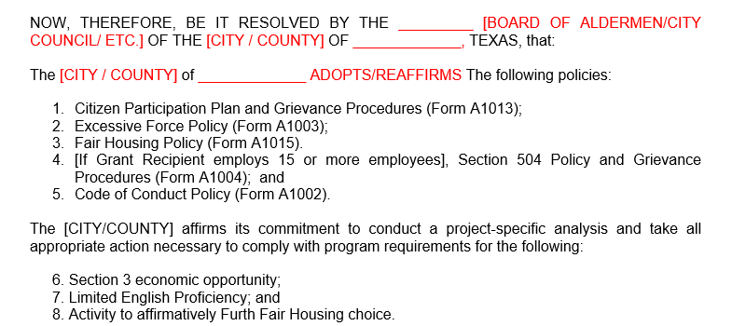
Civil Rights Forms
At the end of the individual policy summaries there will be a list of the corresponding forms being adopted/reaffirmed which should be submitted along with the resolution.
Notes:
This final summary of the required forms for the polices adopted/reaffirmed should act as a guide for the forms that will fulfill the grant recipients Group A requirements as related to civil rights and should be uploaded to the organization’s forms page in TDA–Go. The date resolution is passed/approved along with the local elected official’s signature are located at the bottom of the form.

Slide 13
Civil Rights Forms
Excessive Force Policy - prohibits the use of excessive force against non-violent civil rights demonstrations.
Notes:
The excessive force policy is in accordance with the Housing and Community Development Act and is also a state certification requirement. In signing this agreement, your organization is certifying that you will enforce a policy to protect individuals engaged in non-violent civil rights demonstrations from the use of excessive force by law enforcement and/or from being physically barred from entering or exiting a location that is subject to these demonstrations.
When using the sample forms provided on the TDA website, please remember that you must replace the words in parenthesis or the word SAMPLE with the name of your organization or other applicable information. This will make the approval process move along more smoothly and help to avoid having your documents sent back for corrections.

Slide 14
Civil Rights Forms
Grant Recipients must publish a Citizen Participation Plan, including
methods for encouraging citizen participation as well as complaint procedures.
Notes:
Involvement of the grant recipient's community is critical to the CDBG program. Your organization is responsible for providing for and encouraging citizen participation and especially for LMI persons who live in the target area. This plan must be published to include a method for encouraging citizen participation as well as complaint procedures. Public hearings are a required method of citizen participation for any requests for substantial changes to a CDBG funded project, and after the project is complete. Reasonable advance notice of and opportunity to comment on the proposed change must be provided. Your organization should provide a timely response to all complaints within 15 days where practicable and citizens should have access to the address, phone number, and times for submitting complaints and grievances.

Slide 15
Civil Rights Forms
This form is required as a part of the local resolution and describes requirements of the Texas Government code for procurement related to conflict of interest and nepotism.
Notes:
The purpose of the Code of Conduct is to keep the program honest and fair as it relates to selecting providers and awarding contracts for the work funded by CDBG. Best practice would be to address any issue that may be construed as a conflict of interest as not to interrupt the flow of procurement and even construction. An example would be, if a company shares the same name as the Mayor. Internally, your organization may know there is no relation, but this may cause a red flag during the contract award process and perhaps even in closeout. In this case, TDA would require something in writing from the Mayor refuting that there is a conflict of interest and confirming there is no relation to the contractor. Additional information on conflict of interest and nepotism can be found in Chapter 5 or the Implementation manual.

Slide 16
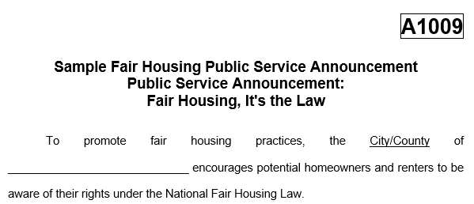
Civil Rights Forms
Fair Housing Activities
Grant Recipients must adopt/affirm a Fair Housing Policy by ordinance or resolution. This includes the declaration of Fair Housing month by proclamation or resolution or publicizing the fair housing policy in the newspaper.
Notes:
HUD’s fair housing website contains an abundance of information and tools for organizations to use in conducting their fair housing activities. Grant Recipients must take at least one more action during the agreement term which publicizes the effort to affirmatively further fair housing. Eligible expenses associated with fair housing activities may count towards the local match requirement or submitted for reimbursement to be paid by CDBG as a part of general administration.
When submitting fair housing activities in the form of a newspaper tearsheet, please keep in mind that the name of the publication, publication date, and page number must be visible. If submitting a publication snippet or photo of public posting a signed affidavit is required.

Slide 17
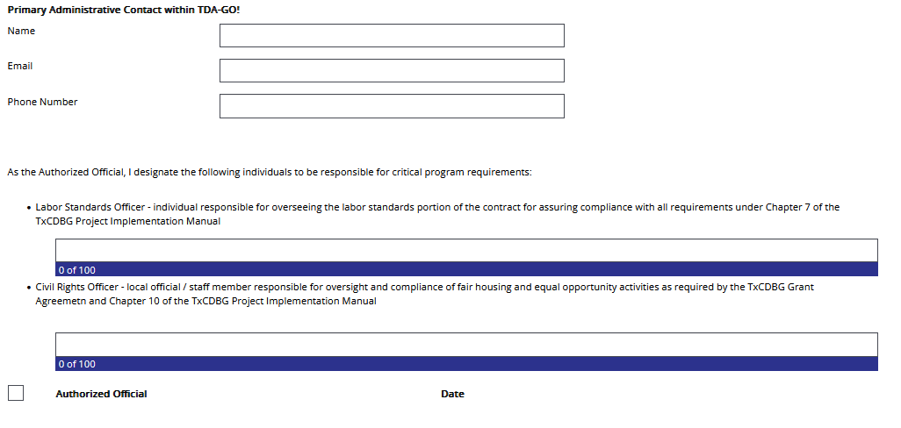
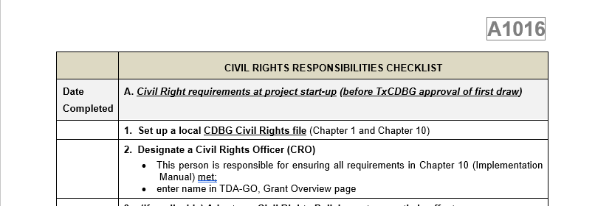
Civil Rights Officer
The Grant Recipient must designate a Civil Rights Officer (CRO) who will be responsible for ensuring all civil rights requirements are met and all documentation related to compliance are submitted to TDA.
Notes:
The Civil Rights Responsibilities Checklist (Form A1016) has recently been updated and can be found under Chapter 10 of the CDBG implementation manual, forms, and appendices page on the TDA website and provides a guide for civil rights requirements.
Please keep in mind that the grant recipient is ultimately responsible for the enforcement of civil rights policies and must appoint a local staff member or official as the CRO. Best practice is to appoint the CRO upon the award of any TxCDBG grant to discuss all required civil rights, equal opportunity, and citizen participation plans and policies. This should occur during a city council or commissioner’s court meeting to ensure that both the CRO and local leadership understand the policies and plans.
The Civil Rights Officer Designation is not a form required to be uploaded and is now a TDA-Go entry. The CRO information field can be located on the Grants Overview Page under the Award tab.

Slide 18
Upload Recap
Forms not listed for upload to Group A,
Policies uploaded to Organization Profile
Are to be uploaded to the Organizations Details page.
Notes:
Please remember that not all civil rights documents will be uploaded to Group A and may need to be uploaded to your organization’s details page. In this case, you will need to add the document name/description yourself in the field provided. Group A can be found under the performance report tab, and you can access your profile by clicking your organization name in the top right corner of the screen and selecting organization details.

Slide 19
For Questions or Technical Assistance:
Grant Implementation
CDBGReporting@TexasAgriculture.gov

