Slide 1
Texas Community Development Block Grant Program
CDBG Over Coffee: Amendments in TDA-GO
Notes:
Good afternoon and welcome to this prerecorded CDBG Over Coffee presentation about Amendments in TDA-GO. I’m Beth Karwoski, a Grant Specialist for the Texas Community Development Block Grant program.
A couple of housekeeping items before we get started.
Please be sure your microphone is muted. We will address questions at the end of the presentation. To ask a question, please type them into the icon that looks like a chat bubble at the top of your screen. If you have project- or community-specific questions, please contact your grant specialist directly or send your question to CDBGReporting@TexasAgriculuture.gov.

Slide 2
Amendments in TDA-GO
Important!
Once an Amendment is Started
CANNOT START NEW
Payment requests
MSR reports
Performance reports
Must contact your Grant Specialist before starting an Amendment
Location Maps!
Consultants can complete or make revisions, but the AO must submit
Save is NOT Submit
Notes:
Before we get into specific details, it is critical that you understand that once an Amendment is started, the system will not allow you to start any new payment requests, Material and Services updates/submissions or Performance Reports. If any related document was started before the Amendment was started, that work can continue, or be edited, as needed.
Before entering an Amendment, you must contact your Grant Specialist. This is a new process for everyone, and they need to be alerted to ensure the process moves quickly.
Location maps are a critical part of TDA-GO agreements. There are 2 maps required with a Performance Statement change. Be sure to review the Implementation Manual guidelines.
Consultants can complete the forms or make revisions, but the AO must submit it. Lastly, remember that the Save button will not Submit a form. Submissions are always going to be a Status Change.

Slide 3
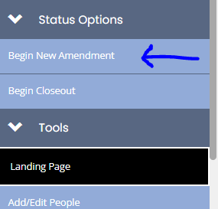
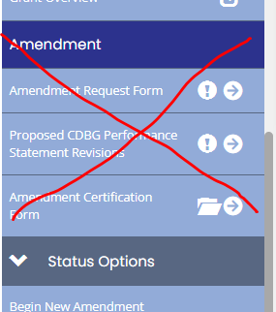
Start an Amendment Status Options > Begin New Amendment
Amendments in TDA-GO
Do not use
Notes:
Be sure you have everything you’ll need to address details and questions in this form before you begin.
Once you are in the agreement to be amended, use the left navigation bar and scroll to the Status Options section, then click Begin New Amendment.
Note: Do NOT use the Amendment section outlined in red to start.

Slide 4
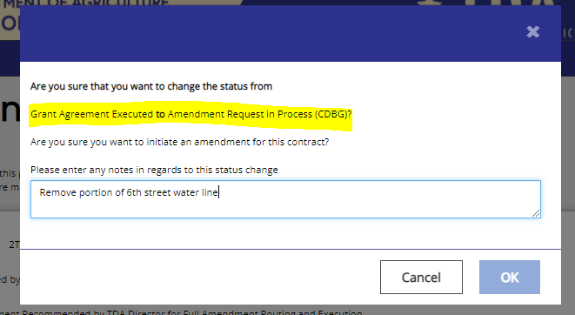
Notes Pop-Up
Amendments in TDA-GO
Notes:
Be sure to stop and read text in a pop-up to be sure you know which step/phase you are at.
Adding notes/details to these pop-ups will save you a lot of time later when searching status history to verify that a need was submitted or a TDA requested change has been sent to you to resolve.
Examples of Notes might be:
Remove portion of 6th street water line
Extend contract 6 months
Move Engineer budget to Construction
Revisions made
Once you’ve entered your note, click OK

Slide 5
Left navigation bar, under Amendment, click Amendment Request Form
Amendments in TDA-GO
Notes:
Now go the Amendment section and click Amendment Request Form.

Slide 6
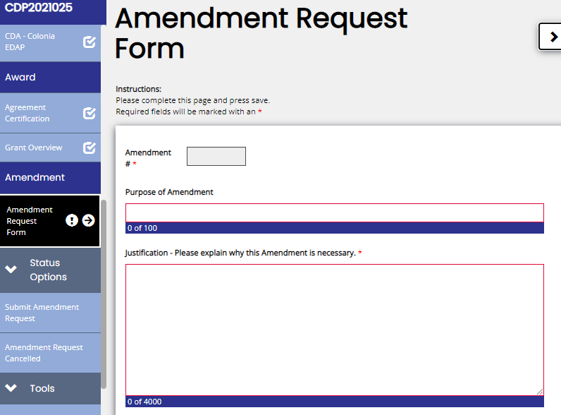
Amendment Request Form
Amendments in TDA-GO
Notes:
The Amendment number will be entered by TDA Staff and numbered sequential 1,2,3…
In the Purpose of Amendment field enter a high level, clear simple reason for the request such as final quantity adjustments, extend contract 6 months, etc.
In the Justification field explain in great detail why TDA should approve the request. The more details you give at the start could prevent a delay in processing.
Now we’ll get into the specifics for Exhibit A, B and/or C change requests. Pay close attention to fields as there are dependencies that must be completed.

Slide 7
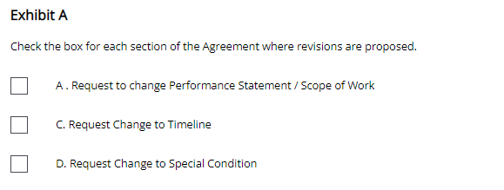
Amendment Request Form: Exhibit A
Amendments in TDA-GO
Notes:
For Exhibit A, there are 3 options for changes.
A. Request Change to Performance Statement
C. Request Change to Timeline
D. Request Change to Special Conditions (This request type will be completed by TDA staff only.)

Slide 8
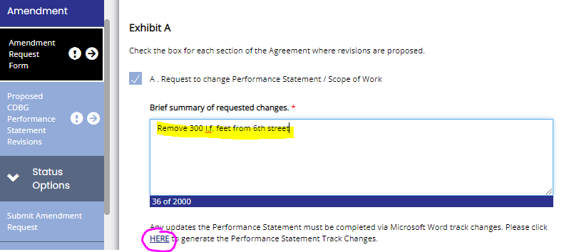
Exhibit A: A Change to Performance Statement
Amendments in TDA-GO
Notes:
When you mark Exhibit A: A Request to change Performance Statement/Scope of Work, you must identify the requested changes. Please explain how the proposed changes still meet the Current Need as described in the Performance Statement, and any impact on beneficiaries. Remember, to connect the dots - a clear explanation of what you are requesting, along with the justification of why as described previously, will avoid delays in the review process.
The text in yellow is an example of a poor summary: Remove 300 l.f. from 6th street. The summary in the red box is what TDA will need:
Remove 300 lf from the 6th street water line. As a result, remove 6 households from the 03J benefit area and 4 households from the 14A benefit area. The remaining beneficiaries will still receive the intended first-time water service.
Once the summary is complete, click HERE to generate the Performance Statement Track Changes document.

Slide 9
Exhibit A: A cont. Change to Performance Statement
Amendments in TDA-GO
The Gad Track Changes doc may load at the bottom of your screen.
Notes:
Depending on your system setup, look for a downloaded document titled Gad_Track_Changes_doc.
Open the downloaded Word document, turn on the track changes feature, and complete any edits being requested. Remember to Save As the document to your computer. Go back to the Exhibit A: A page and click Select to search for and select the document or drag/drop the file as outlined in the field.
Remember to add any supporting documents at the bottom of the screen and click the Save button.

Slide 10
Exhibit A: A cont. Change to Performance Statement
Amendments in TDA-GO
Notes:
After you Save the Gad track changes doc and any other supporting documents, the system will generate a form in the left navigation bar: Proposed CDBG Performance Statement Revisions. This form is like the A1101. All 8 questions must be completed.
If you need additional information and guidance on how to complete this form, refer to TxCDBG Project Implementation Manual Chapter 11.

Slide 11
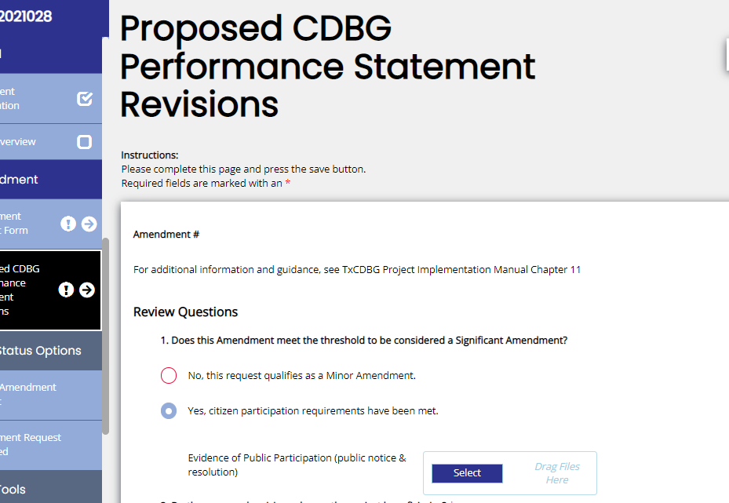
Proposed CDBG Performance Statement Revisions: Question 1
Amendments in TDA-GO
Notes:
Question 1 - Does this Amendment meet the threshold to be considered a Significant Amendment? No or Yes
If yes and citizen participation was met, upload copies of the public notice and resolution.

Slide 12
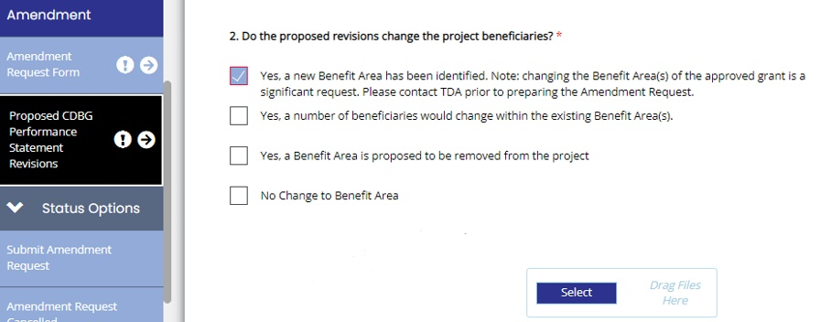
Proposed CDBG Performance Statement Revisions: Question 2
Amendments in TDA-GO
Notes:
Question 2 - Do the proposed revisions change the project beneficiaries?
Any ‘Yes’ answer will require Beneficiary Support documentation to be uploaded.

Slide 13
Proposed CDBG Performance Statement Revisions: Question 3
Amendments in TDA-GO
Notes:
Question 3 - Do the proposed revisions address the same problem identified in the current Performance Statement? Yes/No

Slide 14
Proposed CDBG Performance Statement Revisions: Question 4
Amendments in TDA-GO
Notes:
Question 4 - Do the proposed revisions change the following elements?
If locations identified in original Grant Agreement figure change, you must complete census details and upload 2 required maps.
1 – original project map with color-coded changes clearly marked/identified
2 – clean map after revisions/what the new project would look like
Reminder: If the amendment is approved, these maps will become the Grant Agreement figure, which is why they need to be accurate and clearly defined.
If construction quantities change beyond thresholds, refer to Implementation Manual, Section 11.1.

Slide 15
Amendments in TDA-GO
Proposed CDBG Performance Statement Revisions: Question 5
Notes:
Question 5 - Has the environmental review been re-evaluated for the proposed revisions?
There are 3 responses:
-Environmental review not yet complete,
-New environmental review must be conducted
-Previous completed and cleared environmental review is valid and remains the same.
Note: The Environmental Authorized Official must acknowledge the re-evaluation in the system and the local project director or consultant must complete the re-evaluation form in the Environmental Review Performance Report.

Slide 16
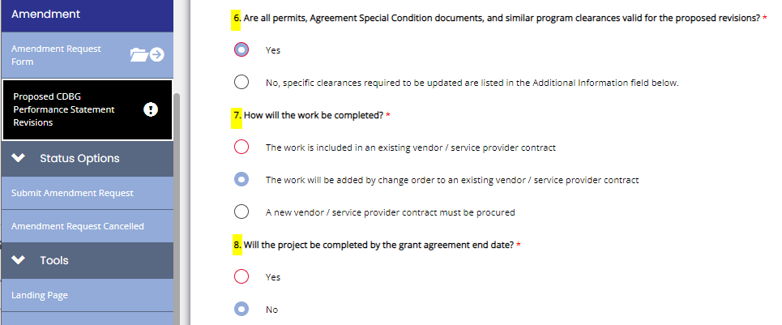
Amendments in TDA-GO
Proposed CDBG Performance Statement Revisions: Question 6 - 8
Notes:
Questions 6 – Are all permits, agreement special condition documents and similar program clearances valid for the proposed revisions?
Yes or No
Question 7 – How will the work be completed? 3 options
Work is included in existing vendor/service provider contract
Work will be added by change order (MSR) to existing vendor/service provider contract
A new vendor/service provider must be procured
Question 8 – Will the project be completed by the grant agreement end date?
Yes or No – if no, be sure to request timeline change- Exhibit A: C, too.

Slide 17
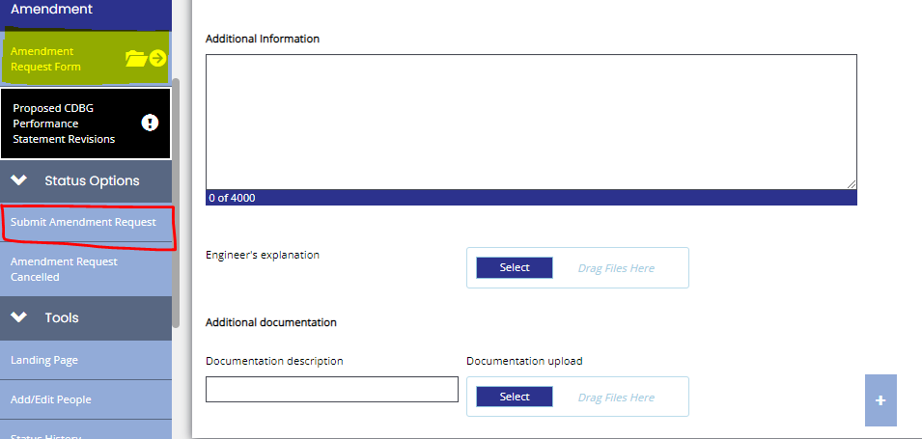
Proposed CDBG Performance Statement Revisions
Amendments in TDA-GO
Notes:
At the bottom of this form there is space:
- To provide any additional information you feel adds clarity for the change(s) and will help expedite the amendment process.
- To upload the Engineer’s explanation. This letter is not required and if submitted should not be the same details already outlined. It should be additional clarification for the reason given, proof of competitive pricing (details for similar work completed or materials used), etc.
To upload other documentation that you feel is important or that you want to have on file in the system with the agreement.
Be sure to click Save in the upper righthand corner.
If you are done & do not have Timeline or Budget Changes, the Authorized Official will need to use the left navigation bar and scroll down to the Status Options section and click Submit Amendment Request marked in red. If a request for a timeline or budget change is needed, click on Amendment Request Form (marked in yellow)

Slide 18
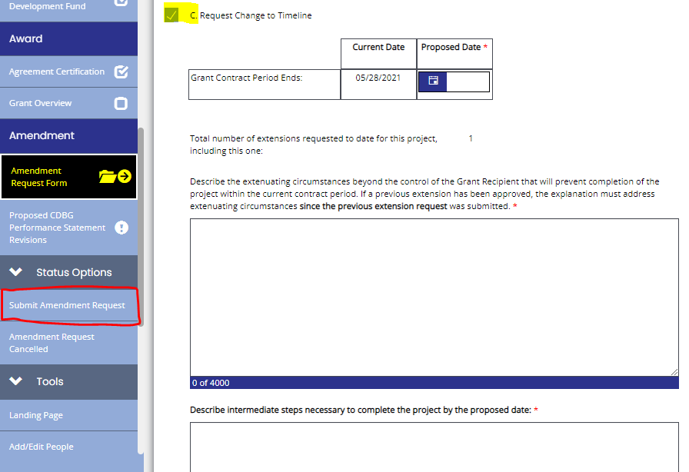
Exhibit A: C Change to Timeline
Amendments in TDA-GO
Notes:
For a Timeline change, scroll down to Exhibit A: C – Request Change to Timeline. You will mark the C and enter the proposed date to end the contract. Then you will need to complete the next 2 fields. Be sure to provide clear and specific details.
1st - describe the extenuating circumstances why the project will not be completed as contracted. What are all the reasons why more time is needed? Example of a poor explanation: COVID or weather. A better explanation would be: Due to pandemic, materials have been difficult to obtain due to shipping delays/low availability.
2nd - describe all the steps that will be taken to ensure the project will be completed by the proposed end date.
Remember to add any supporting documents at the bottom of the screen and click the Save button.
If you do not need a Budget change, the Authorized Official will scroll down the left navigation bar to the Status Options section and click Submit Amendment Request. If a request for a budget change is needed, click on Amendment Request Form (marked in yellow)

Slide 19
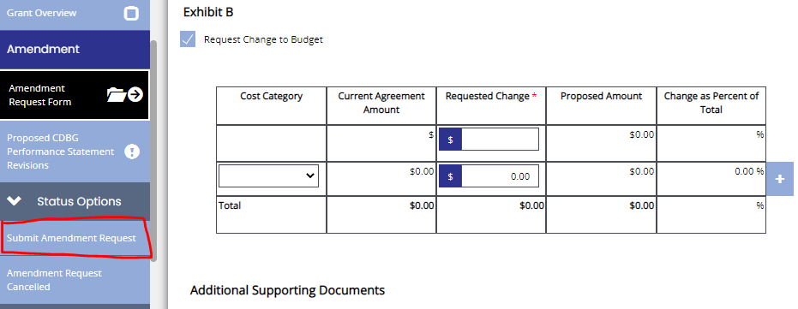
Exhibit B Change to Budget
Amendments in TDA-GO
Notes:
For a Budget change, scroll down to Exhibit B and mark Request Change to Budget. Enter the amounts of grant funding to be moved. Be sure to include a negative sign for funds being moved to another category.
Remember to add any supporting documents at the bottom of the screen and click Save in the upper righthand corner. The Authorized Official will need to use the left navigation bar and scroll down to the Status Options section and click Submit Amendment Request.

Slide 20
What next?
Amendments in TDA-GO
Notes:
A system generated pop-up will appear noting that an Amendment Request has been submitted. When you click OK and you will be back to the agreement.
To check on the status/progress of an amendment, using the left navigation bar scroll down to the Tools section, and click Status History.
To access the most current status, click on column header: Date/Time circled in orange. This will sort the information, putting the newest data at the top of the table.
Note: If the Grant Specialist has questions or needs revisions, they will send you an email and push the Amendment back to you.

Slide 21
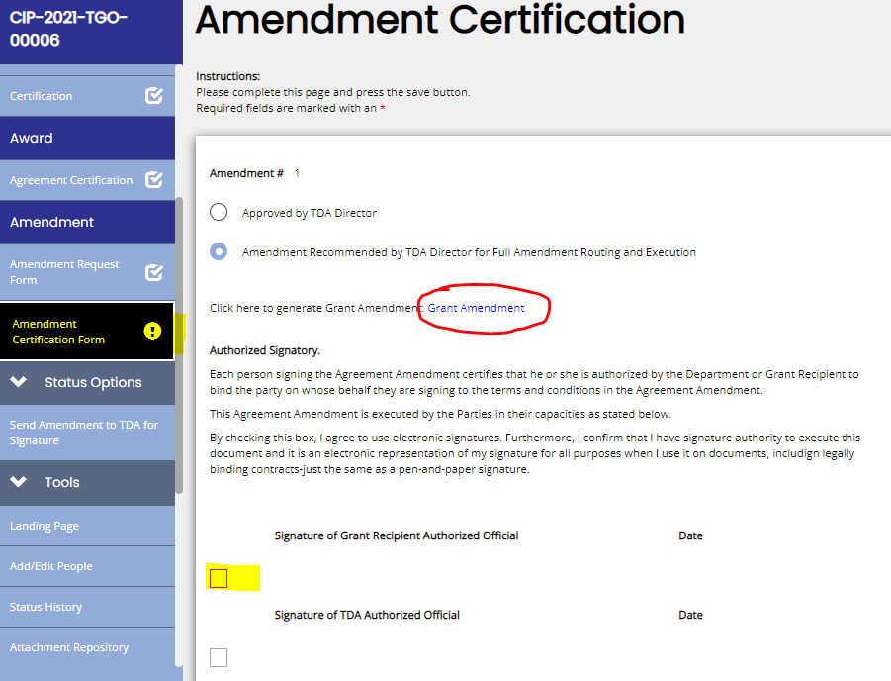
Authorized Official Signature
Amendments in TDA-GO
Notes:
TDA-GO will send an email notification to the Authorized Official, when it is time for them to sign the amendment.
The Authorized Official will go to the Amendment Certification Form and click the Grant Amendment link circled in red and review the document. If they approve, they will check their signature box and the system will automatically complete their name/title and date. The system will then send the amendment to TDA for final signature. Once TDA approves, the process is complete, and the agreement status will go back to Grant Agreement Executed. Submissions can be made for payment requests, Material and Service Reports, or Performance Reports.

Slide 22
For Questions or Technical Assistance
CDBGReporting@TexasAgriculture.gov
Notes:
If you have amendment questions or need technical assistance, email: CDBGReporting@TexasAgriculture.gov or your grant specialist.

